Slide 1

CHAPTER 1
UNDERSTANDING THE CANADIAN
BUSINESS SYSTEM
Copyright © 2014 Pearson Canada Inc.
1-<number>

Slide 2
Learning Objectives
1. Define the nature of Canadian business and identify its main goals.
2. Describe different types of global economic systems, according to the means by which they control the factors of production through input and output markets.
3. Show how demand and supply affect resource distribution in Canada.
4. Identify the elements of private enterprise and explain the various degrees of competition in the Canadian system.
Copyright © 2014 Pearson Canada Inc.
1-<number>
Notes:
These learning objectives are based upon those at the beginning of the chapter. For a review of learning objectives, see the summary at the end of the chapter, as well as the list of key terms.

Slide 3
The Concept of Business and Profit
(LO 1-1)
Businesses produce or sell products in order to make a profit
Non-profit Organizations
  Provide goods and services but do not seek profit
    schools, hospitals
Profit
Revenue
Expense
Copyright © 2014 Pearson Canada Inc.
1-<number>
Notes:
Learning Objective: 1-1
Notes
The text focuses on businesses only, since they generate profits. However, this discussion can be expanded to include other organizations that are active in our society which are not profit-based:
- charitable organizations
- government enterprises
The difference is that the profit motive is not present, so volunteerism is an important part of the organization’s composition.
Activity
Have students research a corporation in the library using the corporate reports. Have the students work in groups to identify the products/services sold, and the profitability of the firm in return for risking its assets to produce the goods.

Slide 4
Factors of Production
Key difference between economic systems is how they manage factors of production – basic resources a country’s businesses use to produce goods and services
© 2014 Pearson Education Ltd.
1-<number>

Slide 5
Economic Systems Around the World
(LO 1-2)
Human Resources
Entrepreneurs
Capital
The Factors of Production
Resources used by firms to create goods and services
Natural Resources
Information Resources
Copyright © 2014 Pearson Canada Inc.
1-<number>
Notes:
Learning Objective: 1-2
Table 1.1
Notes
The Factors of Production are basic resources which are the building blocks of an economic system, include:
natural resources: minerals, lumber, water, land
labour: human production, expertise
capital: money needed to run a business which comes from investment, borrowing or sales
entrepreneurs: the people who organize and manage the factors of production in a business environment in order to produce a profit, risking failure and loss
information: (now often included) – specialized knowledge, economic data
Activities
Questions for Analysis #1, #6
Application Exercises #1

Slide 6
Types of Economic Systems
(LO 1-2)
Market Economies
Command Economies
Capitalism
Mixed Economy
Socialism
Communism
How does each system manage their factors of production?
Copyright © 2014 Pearson Canada Inc.
1-<number>
© 2014 Pearson Education Ltd.
1-<number>
Notes:
Learning Objective: 1-2

Slide 7
Types of Economic Systems
(LO 1-2)
Command Economies
Communism
  Government owns and operates all industries
  It makes decisions regarding distribution of resources
Socialism
  Government owns and operates all critical industries
    utilities and major institutions
  Individuals own non-critical businesses
Copyright © 2014 Pearson Canada Inc.
1-<number>
Notes:
Learning Objective: 1-2

Slide 8
Types of Economic Systems
(LO 1-2)
Market Economies
  Economic basis is supply and demand
  Political basis is capitalism
  Ownership of the factors of production is open
  Buyers and sellers have freedom of choice
  The market is the mechanism for the exchange of goods and services
Copyright © 2014 Pearson Canada Inc.
1-<number>
Notes:
Learning Objective: 1-2
Notes
In a market economy:
Demand is willingness of consumers to buy a product or service
Supply is the willingness and ability of producers to sell the product or service
The issue of supply and demand is further discussed in additional slides for this chapter, and in the discussion of supply, demand, and price determination in the text.
The issue of choice, ability and interest are all freedoms which students identify with. They tend to approach this from a very strong cultural bias. Through discussion construct a table on the board illustrating the strengths of living in a planned, vs. a market, economy. Force them to list strengths and weaknesses of both systems.

Slide 9
Types of Economic Systems
(LO 1-2)
Capitalism
  Encourages entrepreneurship and the private ownership of the factors of production
  Encourages profit making as an incentive
  Operates under the concept of supply and demand
Copyright © 2014 Pearson Canada Inc.
1-<number>
Notes:
Learning Objective: 1-2

Slide 10
Types of Economic Systems
(LO 1-2)
Mixed Market Economies
  Combination of both command and market economies
  No country has a pure communist, socialist, or capitalist system
  Privatization
    converting government firms into privately owned companies, e.g. air traffic control system, Canadian National Railway, Air Canada
  Nationalization
    the conversion of private firms into government-owned firms, e.g. Venezuela
  Deregulation
    reducing laws and government intervention
Copyright © 2014 Pearson Canada Inc.
1-<number>
Notes:
Learning Objective: 1-2
Notes
China is encouraging entrepreneurial activity
Russia has returned to a non-communist regime
In Canada, many “necessities” or “essential services” are supplied by the state
Activities
Have students analyze the Canadian government system. This is a mixed economy. Let them indicate which aspects of the economic system are controlled by government.
Expand on the first activity by having students compare Canada’s level of government regulation with that of the United States. Then, let them describe which system is more socialistic, capitalistic, etc.

Slide 11
Types of Economic Systems
(LO 1-2)
Interactions between Business and Government
Customer
Competitor – Crown corp’s
Regulator
Taxation Agent
Provider of Incentives
Provider of Essential Services
Copyright © 2014 Pearson Canada Inc.
1-<number>
Notes:
Learning Objective: 1-2
Table 1.1
Table 1.2
Notes
Government Competes: the government often sells the same products or services which private business does. Crown corporations are an example Economic Administration: the government uses various administrative methods to rule as required, including: boards, tribunals, commissions. Other regulatory agencies include organizations such as the CRTC.
Government Regulation: the government regulates many industries (transportation, banking, etc.) although the emphasis today is towards deregulation. Key areas of regulation include protecting competition, consumer protection, meeting social/safety goals, and the environment.
Taxation: the government collects tax revenue from various sources (income, restricted products (tobacco, alcohol).
Providing Incentives: government provides funding and other specialized programs to encourage business development, employment and other agenda items (e.g.: Industrial and Regional Development Program).
Providing of Services to Businesses: government assists business through trade commissions worldwide, Stats Canada reports, maps, export development.
Buying from Business: the government is a leading customer of an infinite array of goods and services purchased from the private sector.
Providing Essential Services: the government maintains the infrastructure required to maintain the market system including highways, buildings, school, hospitals, and other essential services.
Activities
Have students write a summary on one or more of the above governmental roles for class discussion.
Analysis Question #2,5

Slide 12
Types of Economic Systems
(LO 1-2)
Government as Regulator
Regulates through administrative boards, tribunals, and commissions, e.g. CRTC
Promotes healthy competition between businesses, e.g. anti-competitive behaviour
Protects consumers, e.g. Tobacco Act, Textile Labelling Act
Achieves social goals
Protects the environment, e.g. Fisheries Act, Canada Water Act
Copyright © 2014 Pearson Canada Inc.
1-<number>
Notes:
Learning Objective: 1-2

Slide 13





Types of Economic Systems
(LO 1-2)
Government as Taxation Agent
Revenue Tax
Progressive Revenue Tax
Regressive Revenue Tax
Restrictive Tax
Income Tax
Copyright © 2014 Pearson Canada Inc.
1-<number>
Notes:
Learning Objective: 1-2
Notes
Income tax is the primary tax in effect in Canada. A tax is progressive if those with higher incomes pay a higher percent of their income on taxes. Generally, income taxes are designed to be a progressive tax.
A tax is regressive if those with lower incomes pay a higher percent of their income in taxes. Sales taxes have the effect of a regressive tax. This occurs because those with lower incomes spend a higher percent of their incomes in stores than do their richer counterparts. This means that they pay a higher percent of their income in sales taxes than do those with more money.
Activity
Statistics Canada produces a wealth of census data which reflect the spending patterns of Canadian. Have students investigate the Stats Can tables to demonstrate statistically:
1) the progressive nature of the income tax system
2) the regressive nature of sales taxes
Have students then use the tables to argue whether or not liquor and tobacco taxes are regressive or progressive in nature.

Slide 14
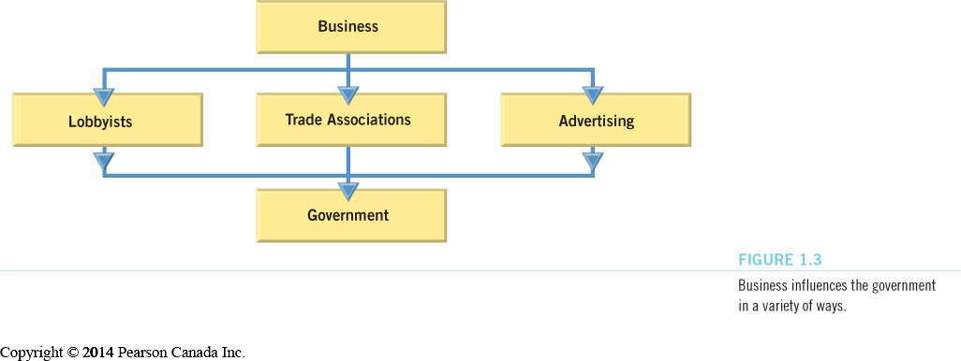
Types of Economic Systems
(LO 1-2)
How Business Influences Government
Copyright © 2014 Pearson Canada Inc.
1-<number>
Notes:
Learning Objective: 1-2
Figure 1.3
Notes
Lobbyists are individuals or organizations whose job is to influence key policymakers to make decisions which favour their clients. Lobbyists must be registered in accordance with the Lobbying Act, in order to do business in Canada. Lobbyists use personal persuasion as well as advertising to accomplish their objectives.
Trade associations, such as chambers of commerce and employee groups also attempt to influence the vote of parliamentarians. Business works directly through its various trade associations to sway opinion of both the general public and policy makers.
Voters can be influenced by business, trade associations, advertising, and politicians.
Activities
Divide students into groups of three or four. Assign each group a politically “hot” topic, such as offshore oil rights, environmental protection, the right of tobacco and alcohol producers to access broad promotion. Then, tell them they must lobby in favour of the cause. Have them prepare a platform and present it. To add to the excitement, have other groups act as politicians with their own personal opinions. Have the “lobby” group attempt to convince the “politicians” to support their cause.

Slide 15
Types of Economic Systems
(LO 1-2)
Government as Provider of Incentives
  Government provides aid and assistance to small businesses and non-profit organizations
  Incentives stimulate growth in revenues and employment
Copyright © 2014 Pearson Canada Inc.
1-<number>
Notes:
Learning Objective: 1-2
Notes
Government assists business and influences its growth by offering various assistance programs or “incentives.” Such incentive may include offering financial help, training and/or information to assist a firm to export Canadian goods. These programs are often geared to specific low growth regions across the country.
Examples:
Export Development Corporation
Energy, Mines and Resources Canada
Industrial Regional Development Program
Industrial Assistance Programs
Atlantic Canada Opportunities Agency (ACOA)
Activities
Proponents of assistance programs argue that it brings hope of prosperity to under developed economic regions. Opponents of such programs insist that it creates a “grant mentality” that if you can get the money you can do it. That many businesses spawned with such programs are weak and non-competitive and unable to make it on their own. Let students debate this issue.

Slide 16









Types of Economic Systems
(LO 1-2)
Government as Provider of Essential Services
  All three levels of government provide various services:
Copyright © 2014 Pearson Canada Inc.
1-<number>
Notes:
Learning Objective: 1-2
Activities
Some people believe that some essential services should be privatized. The argument is that privatizing such services would increase service levels and decrease costs, thereby making them more efficient. The government has been moving to streamline such services as health care and education, but they have stopped short of actually privatizing them. Have students discuss the pros and cons of privatizing the services listed on the slide and in the text.

Slide 17
Supply and Demand
(LO 1-3)
Laws of Supply and Demand
The law of demand: buyers purchase more of a product as its price drops and less of a product as its price increases
The law of supply: producers offer more of a product as the price rises and less as its price drops
Copyright © 2014 Pearson Canada Inc.
1-<number>
Notes:
Learning Objective: 1-3
Notes
Shortage: a lack of supply
Limited supply will shift the Supply Curve sideways to the left.
This will create a new equilibrium price crossing the Demand Curve at a higher price point than normal.
This shows that shortages drive prices up.
Individual suppliers will lose potential revenue from selling more units even at lower prices.
The lack of supply can anger consumers and destroy their confidence in the market and its suppliers.
Suppliers attempt to produce the number demanded to avoid shortages or surpluses which are ultimately damaging and reduce profits.

Slide 18
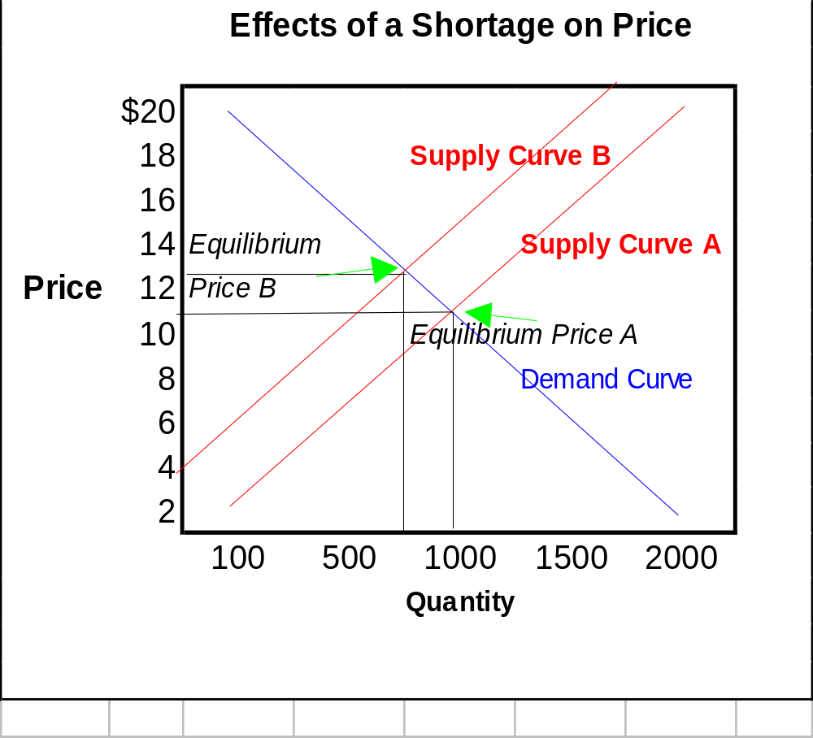
Supply and Demand
(LO 1-3)
Dealing with a Shortage
A shortage
drives
prices
up
Copyright © 2014 Pearson Canada Inc.
1-<number>
Notes:
Learning Objective: 1-3
Notes
Shortage: a lack of supply
Limited supply will shift the Supply Curve sideways to the left.
This will create a new equilibrium price crossing the Demand Curve at a higher price point than normal.
This shows that shortages drive prices up.
Individual suppliers will lose potential revenue from selling more units even at lower prices.
The lack of supply can anger consumers and destroy their confidence in the market and its suppliers.
Suppliers attempt to produce the number demanded to avoid shortages or surpluses which are ultimately damaging and reduce profits.

Slide 19
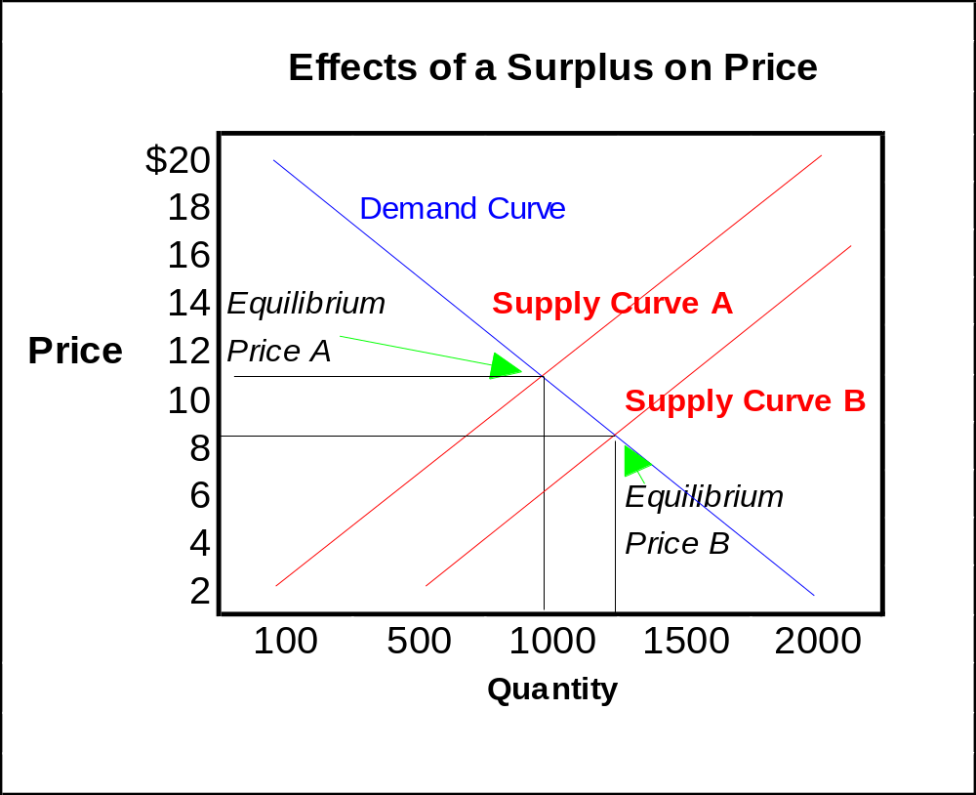
Supply and Demand
(LO 1-3)
Dealing with a Surplus
A surplus
drives
prices
down
Copyright © 2014 Pearson Canada Inc.
1-<number>
Notes:
Learning Objective: 1-3
Notes
Surplus: an abundance of supply
Extra supply will force the Supply Curve to shift sideways to the right.
This will create a new equilibrium price crossing the Demand Curve at a price point which is lower than normal.
This shows that surpluses drive prices down.
Individual suppliers will have waste and lose profits.
Activities
Analysis Question #4

Slide 20
Private Enterprise & Competition in a Market Economy
(LO 1-4)
Private enterprise occurs in a market economy with little government restriction
Under this system individuals
  can own property
  have freedom of choice
  have the freedom to earn profits
  have freedom to compete
Copyright © 2014 Pearson Canada Inc.
1-<number>
Notes:
Learning Objective: 1-4
Activity
Class Discussion: Private property is a basic right that most of us take for granted. Give examples of how some people in non-capitalist nations do not have our right to private property. How would students respond if their rights were suddenly gone? How much of their future career prospects revolve around the freedom to acquire and control their own property? Does one’s property define who and what they are in our consumer-oriented society?

Slide 21
Private Enterprise & Competition in a Market Economy
(LO 1-4)
Competition
  occurs when businesses vie for the same resources or customers in a particular market or industry.
    motivates business to operate efficiently
    forces business to make products better or cheaper
Copyright © 2014 Pearson Canada Inc.
1-<number>
Notes:
Learning Objective: 1-4

Slide 22
Private Enterprise & Competition in a Market Economy
(LO 1-4)
Degrees of Competition
Perfect Competition
Monopolistic Competition
Oligopoly
Monopoly
Copyright © 2014 Pearson Canada Inc.
1-<number>
Notes:
Learning Objective: 1-4
Notes
The degrees of competition are influenced by:
The number of firms competing for the same consumer’s dollar
The similarity of their products or services in the eyes of consumers
This influences the firms by:
Giving them more, or less, control over price depending on various factors
Making it more difficult to compete, or not, depending on various factors
Activities
Application Exercises # 2, 3

Slide 23
Private Enterprise & Competition in a Market Economy
(LO 1-4)
Perfect Competition
  Has many sellers and the product is basically identical
  Relatively easy to enter the industry
  Individual firms have no control
  over price—the buyer will purchase from the lowest price source
Copyright © 2014 Pearson Canada Inc.
1-<number>
Notes:
Learning Objective: 1-4
Notes
Pure competition:
increasingly, cellular telephone dealers
corner stores
candy manufacturers (like Cadbury, Nestle) notwithstanding consumer preference for some chocolate bars
Activities
Question for Analysis #4

Slide 24
Private Enterprise & Competition in a Market Economy
(LO 1-4)
Monopolistic Competition
  Has few to many sellers
  The product is seen as unique by some buyers, but not necessarily all
  A differentiated brand provides the firm with some control over pricing
Copyright © 2014 Pearson Canada Inc.
1-<number>
Notes:
Learning Objective: 1-4
Notes
Typical examples of monopolistic competition:
most consumer products where some of the clients may be loyal, but not all (eg: Tide, McDonald’s burgers)

Slide 25
Private Enterprise & Competition in a Market Economy
(LO 1-4)
Oligopoly
  A few large suppliers dominate the market
  High barriers to entry
  The products are seen as similar; no supplier has an edge
  Each supplier knows what the others are charging
  Prices gravitate toward a common “market price”
Copyright © 2014 Pearson Canada Inc.
1-<number>
Notes:
Learning Objective: 1-4
Notes
Oligopolies are confusing because some have more than a few contenders. The operational issue in these cases is that the few are large enough to dominate the market.
If one raises his/her price, they will lose sales to the others
If one lowers his/her price, the others will lower prices to compete and everyone earns less money
Examples typically include:
Automobiles
Retail gasoline dealers
Sugar producers

Slide 26
Private Enterprise & Competition in a Market Economy
(LO 1-4)
Monopoly
  One producer and source of supply
  Unique product
  Complete control over price
  No competitors
Copyright © 2014 Pearson Canada Inc.
1-<number>
Notes:
Learning Objective: 1-4
Notes
In Canada, most monopolies are regulated to avoid price gouging.
It is a “natural monopoly” if the one entity can supply the product more efficiently than many companies (e.g.,: electric power in Canada).
Popular examples of monopolies:
cable provider (but losing it)
electric utilities (a natural utility in most cases)

Slide 27
Private Enterprise & Competition in a Market Economy (LO 1-4)
Natural Monopoly
  A market or industry in which having only one producer can sufficiently meet demand
  It is the most efficient approach
    electric power utility
Copyright © 2014 Pearson Canada Inc.
1-<number>
Notes:
Learning Objective: 1-4
Activities
Have students try to list other “natural monopolies.” Have them debate the issue: Is there really a natural monopoly, or do all monopolies lead to inefficiencies and higher prices. Is competition necessary to ensure a fair market economy?

